Slide 1
BoulderDash Project
DELTOUR Hugo – GILLY Pierre – MAISANO Robin

Slide 2
Summary
Project Presentation
How does project basically works
View explanation (Hugo)
Controller explanation (Robin)
Model explanation (Pierre)
Contract explanation (Robin)
Project Organization (Tasks, Repartition & Progress)
Conclusion
Questions
Notes:
Every single one of us will present his part of the game and explain the main functions

Slide 3
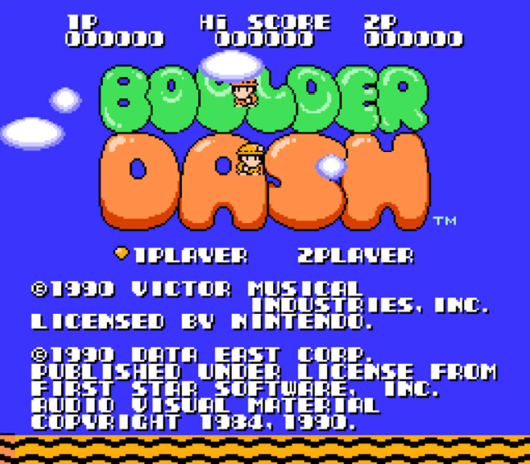
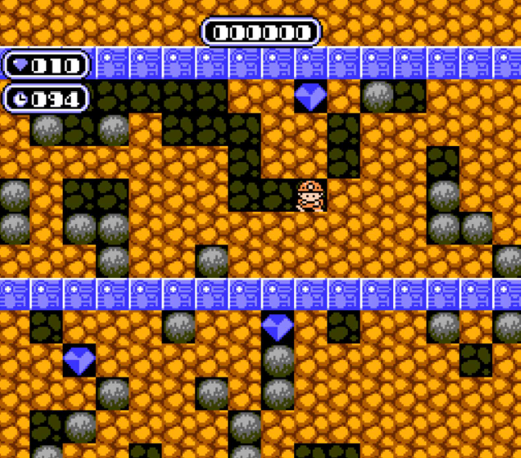
Project Presentation
Code the old game Boulder Dash and keep :
Original game rules
Original game physics rules
Original sprite (same look for game elements)
Project Presentation
Controller explanation
Model explanation
Contract explanation
Conclusion
Questions
Project Organization
How does project basically works
View explanation

Slide 4
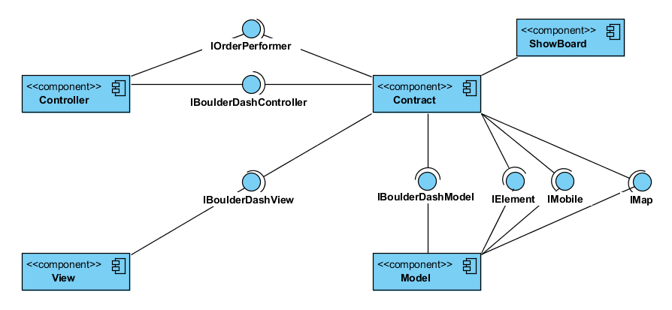
How does project works
All Interfaces stocked and
accessible in “Contract”
Project Presentation
Controller explanation
Model explanation
Contract explanation
Conclusion
Questions
Project Organization
How does project basically works
View explanation

Slide 5
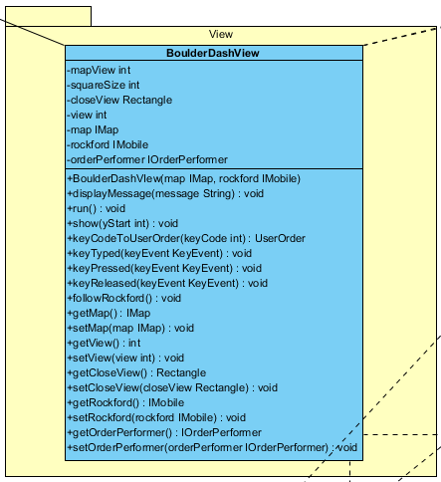
View explanation
Package View
Project Presentation
Controller explanation
Model explanation
Contract explanation
Conclusion
Questions
Project Organization
How does project basically works
View explanation

Slide 6
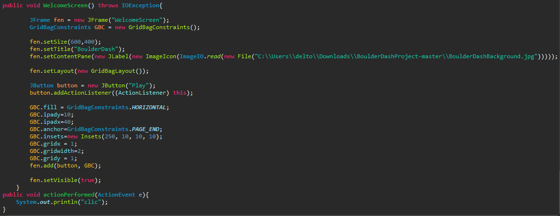
View explanation
Methods to make and display a frame
Project Presentation
Controller explanation
Model explanation
Contract explanation
Conclusion
Questions
Project Organization
How does project basically works
View explanation

Slide 7

Controller explanation
What is the controller?
Game Loop
Rules the game
Contain the game loop
Permit objects interaction and communication
Object
Object
Object
Controller
Object
Project Presentation
View explanation
Controller explanation
Model explanation
Contract explanation
Conclusion
Questions
Project Organization
How does project basically works

Slide 8
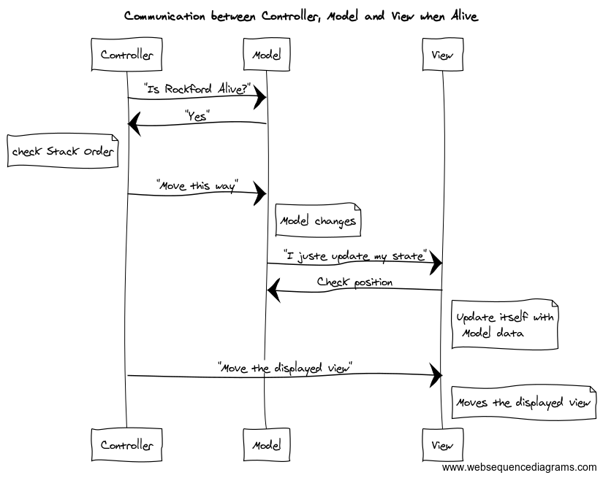
Controller explanation
How does it works?
Each loop turn :
Take elements from Model
Pass it through tests
Order model to update the element position
Order view to update itself
Project Presentation
View explanation
Controller explanation
Model explanation
Contract explanation
Conclusion
Questions
Project Organization
How does project basically works
Notes:
Game loop continue until player wins or loses
React when player press a key

Slide 9
Controller explanation
Why is it important?
Game engine, gameplay depend completely of him
Make each game component communicate together
Gives order to components
Project Presentation
View explanation
Controller explanation
Model explanation
Contract explanation
Conclusion
Questions
Project Organization
How does project basically works

Slide 10
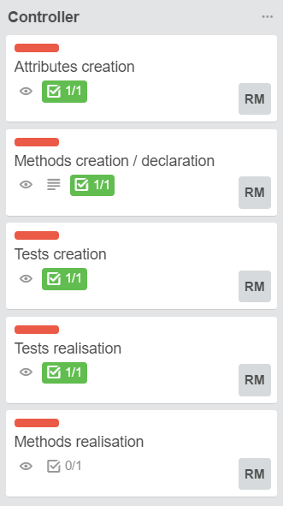
Controller explanation
Progress
Project Presentation
View explanation
Controller explanation
Model explanation
Contract explanation
Conclusion
Questions
Project Organization
How does project basically works

Slide 11

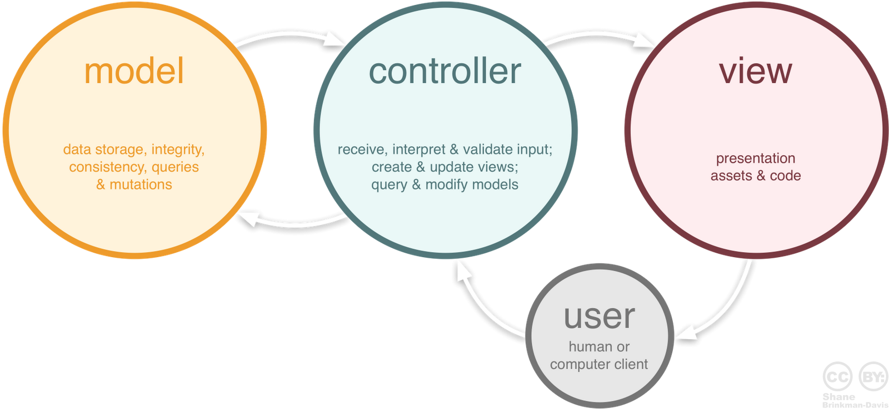
Model explanation
What is the model?
Model
Biggest Part
Map
Characters
Objects
Query
Project Presentation
View explanation
Controller explanation
Model explanation
Contract explanation
Conclusion
Questions
Project Organization
How does project basically works

Slide 12
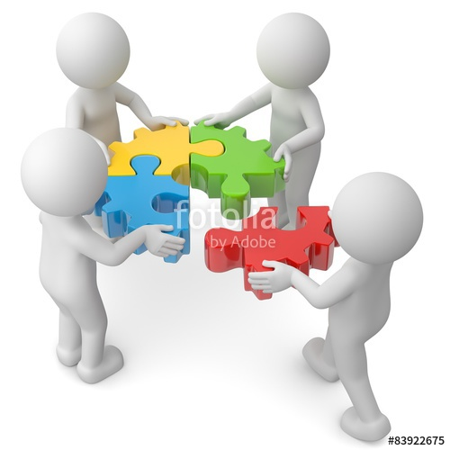
Model explanation
How does it work?
Model
Mobile element
Motionless element
Map
DAL
Project Presentation
View explanation
Controller explanation
Model explanation
Contract explanation
Conclusion
Questions
Project Organization
How does project basically works

Slide 13
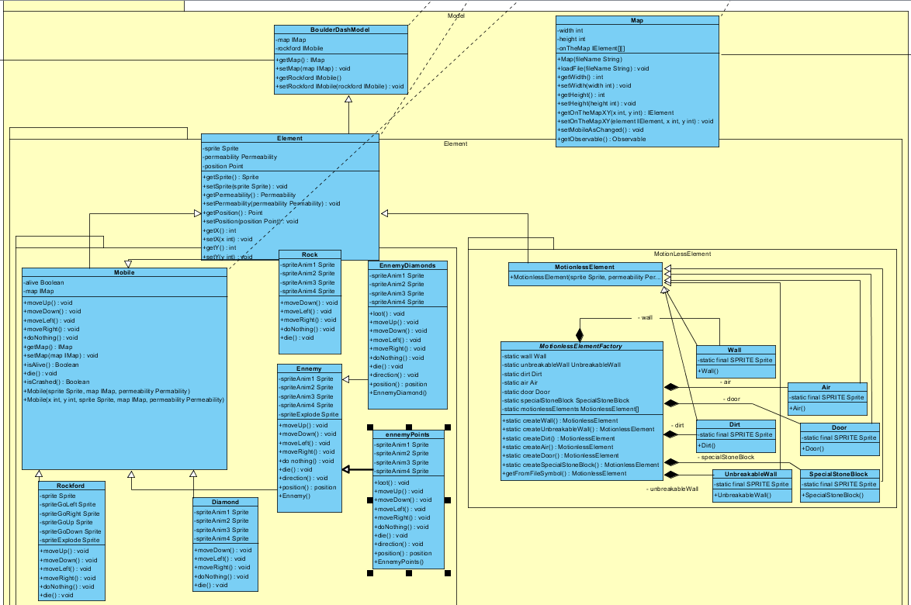

Model explanation
What does it looks like?
Project Presentation
View explanation
Controller explanation
Model explanation
Contract explanation
Conclusion
Questions
Project Organization
How does project basically works

Slide 14

Model explanation
Why it’s important?
Elements
Rewards
Heroes
Objects
Map
Ennemy
Project Presentation
View explanation
Controller explanation
Model explanation
Contract explanation
Conclusion
Questions
Project Organization
How does project basically works

Slide 15


Model explanation
Progress
Project Presentation
View explanation
Controller explanation
Model explanation
Contract explanation
Conclusion
Questions
Project Organization
How does project basically works

Slide 16
Contract explanation
Interfaces
Project Presentation
View explanation
Controller explanation
Model explanation
Contract explanation
Conclusion
Questions
Project Organization
How does project basically works

Slide 17
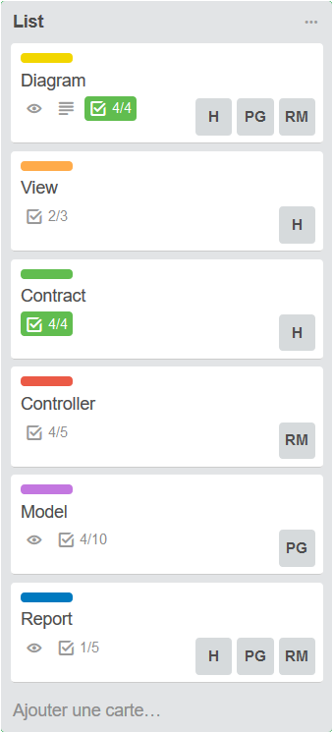
Project Organization
Tasks, Repartition & Progress
Project Presentation
View explanation
Controller explanation
Model explanation
Contract explanation
Conclusion
Questions
Project Organization
How does project basically works

Slide 18
Conclusion
Results
Project Presentation
View explanation
Controller explanation
Model explanation
Contract explanation
Conclusion
Questions
Project Organization
How does project basically works

Slide 19
Questions
Thank you for your attention.
We will be pleased to answer any question you have.

